Slide 1

CNN AND CONFORMERS
Key Word Spotting
Presented By : Juswanth T
EE21B063
IIT Madras | 2024

Slide 2
1
KEY WORD SPOTTING
Keyword spotting (KWS) is a technique used in speech processing to detect specific words or phrases within a stream of audio. The primary goal of keyword spotting is to identify when a particular keyword or set of keywords is spoken, enabling various applications such as voice command systems, speech analytics, and hands-free device activation (e.g., "Hey Siri" or "OK Google").
IIT Madras | 2024

Slide 3
HOW IT WORKS?
2
1
Preprocessing:
Feature Extraction: The audio signal is converted into a set of features, typically using techniques like Mel-frequency cepstral coefficients (MFCCs) or log Mel-filterbank energies .
Frame Segmentation: The audio is divided into short frames, allowing the system to analyze small segments of the signal sequentially.
Adding Noise to make it more robust
Model Training:
Training Data: A large dataset of audio samples containing the target keywords and other speech is used.
Machine Learning Models: Various models can be employed for keyword spotting, including traditional approaches like Hidden Markov Models (HMMs) and more modern techniques like deep neural networks (DNNs), convolutional neural networks (CNNs), recurrent neural networks (RNNs), Conformers and many more.
Detection:
Keyword Identification: The model analyzes the features to determine the likelihood of the presence of the target keywords. In our case its a classification problem where the model tries to detect from 35 different key words.
2
3
IIT Madras | 2024

Slide 4
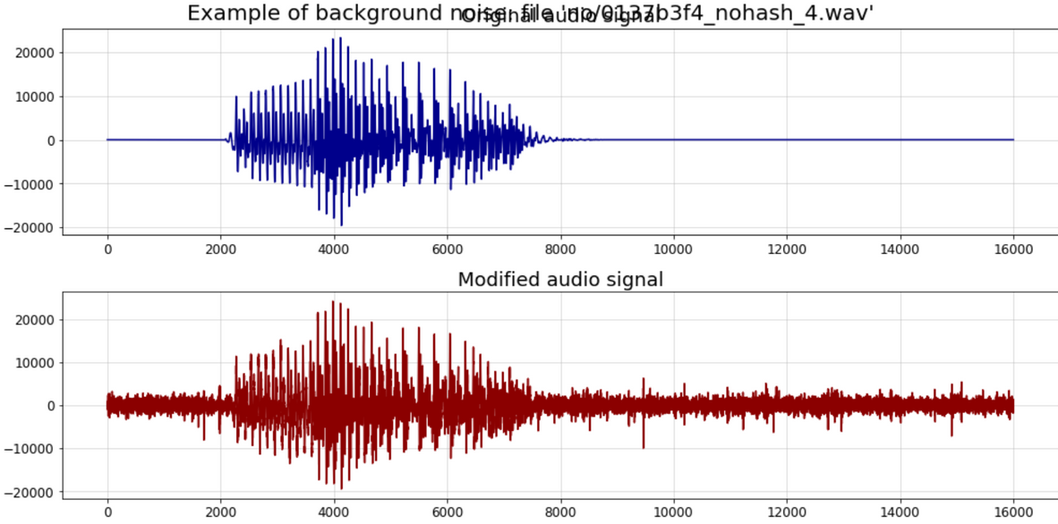
3
NOISE ADDTION
Robustness:
Adding noise can make the model more robust to real-world conditions where the input data may contain unexpected noise
IIT Madras | 2024
Preventing Overfitting
Noise can also act as a form of regularization, preventing the model from fitting too closely to the training data and thus helping to prevent overfitting

Slide 5
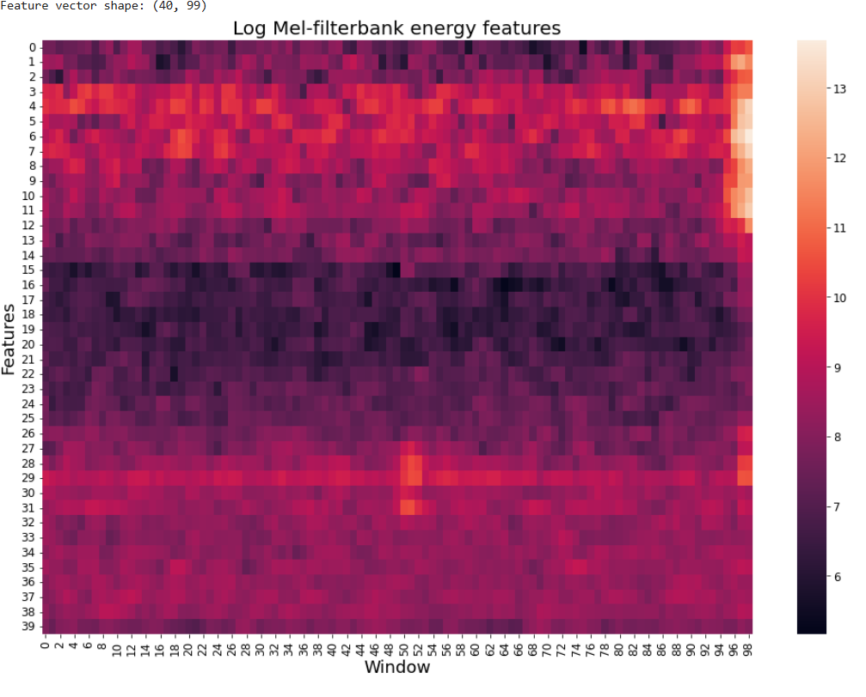
Log Mel-Filterbank Energy Feature plot
4
Dark colors (towards black) indicate lower energy.
Light colors (towards white) indicate higher energy.
IIT Madras | 2024

Slide 6
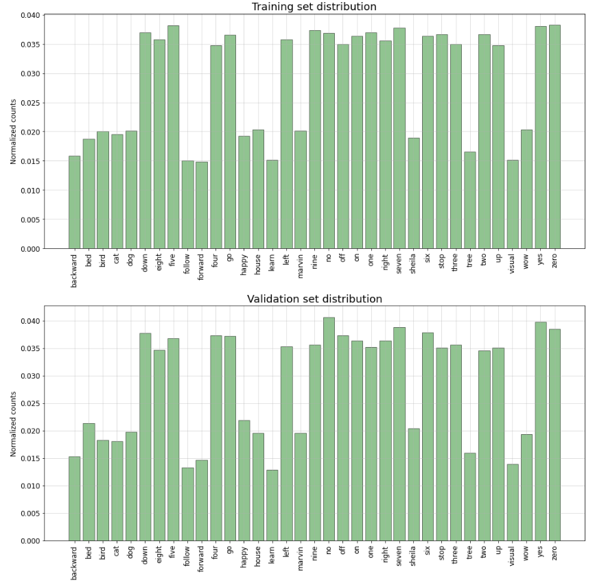
5
TRAINING SET
number of audio files: 84843
percentage of audio files: 80.17%
VALIDATION SET
number of audio files: 9981
percentage of audio files: 9.43%

Slide 7
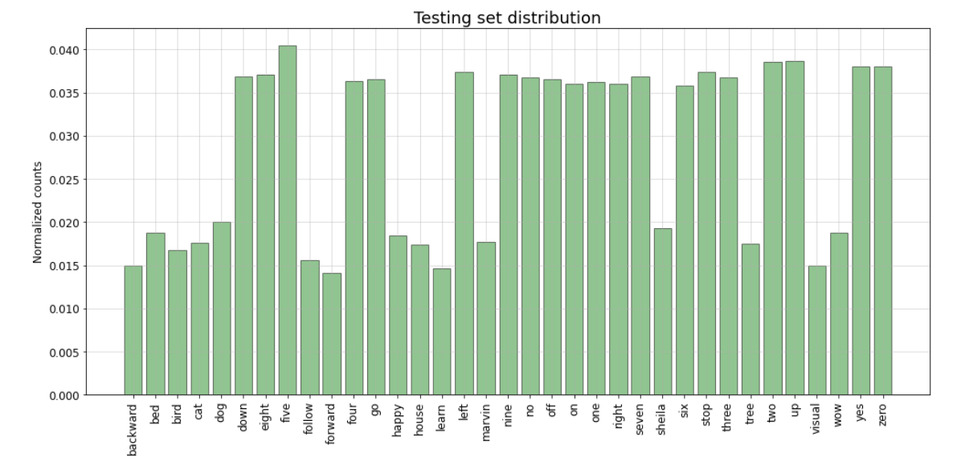
6
TEST SET
number of audio files: 11005
percentage of audio files: 10.40%

Slide 8
7
CONFORMERS
CONVOLUTION AUGMENTED TRANSFORMER
IIT Madras | 2024

Slide 9
8
KEY COMPONENTS OF THE CONFORMER
Convolutional Layers
Transformer Layers
Convolutional layers are effective at capturing local patterns in the input data. For speech, this means they can extract features related to short-term dependencies in the audio signal.
Transformer layers, with their self-attention mechanisms, excel at capturing long-range dependencies and global context in sequences.
IIT Madras| 2024

Slide 10
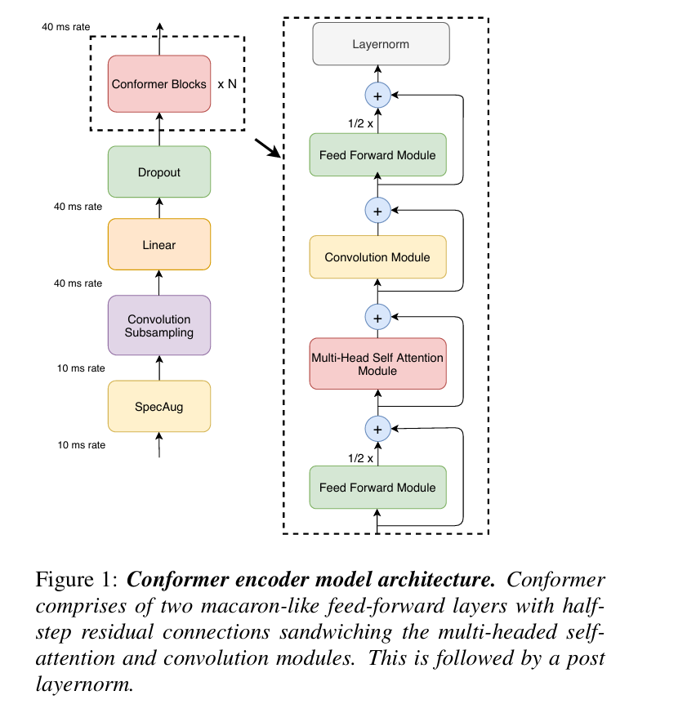
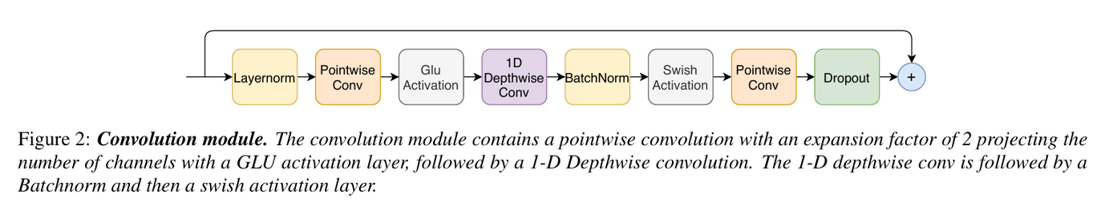
ARCHITECTURE
9
The Conformer architecture integrates convolutional layers into the Transformer blocks, enabling the model to learn both local and global features simultaneously.
IIT Madras| 2024

Slide 11
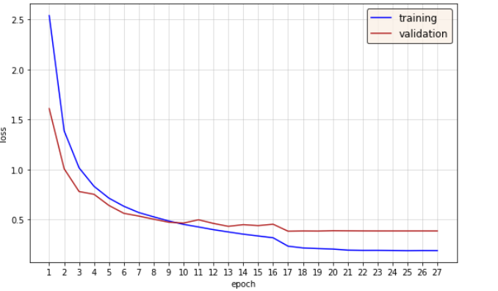
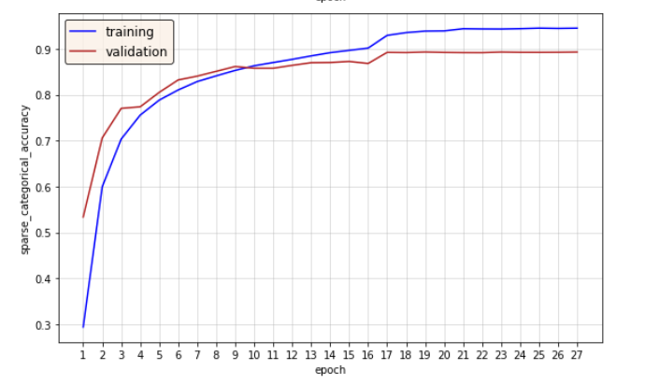
LOSS AND ACCURACY
10
IIT Madras| 2024

Slide 12
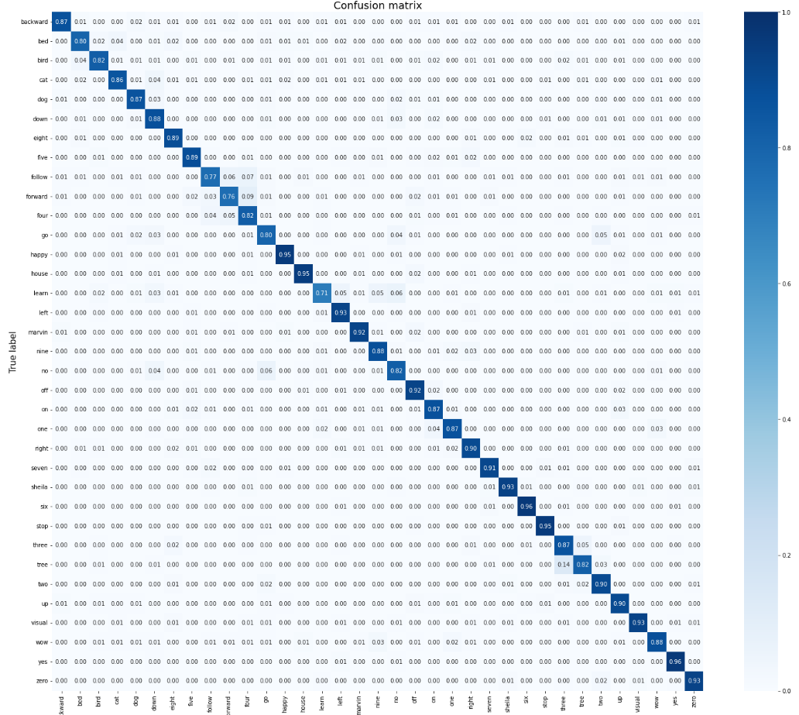
11
﻿RESULT
ACCURACY ON TEST DATA : 88.4%
IIT Madras | 2024

Slide 13
12
CNN ARCHITECTURE
IIT Madras | 2024

Slide 14
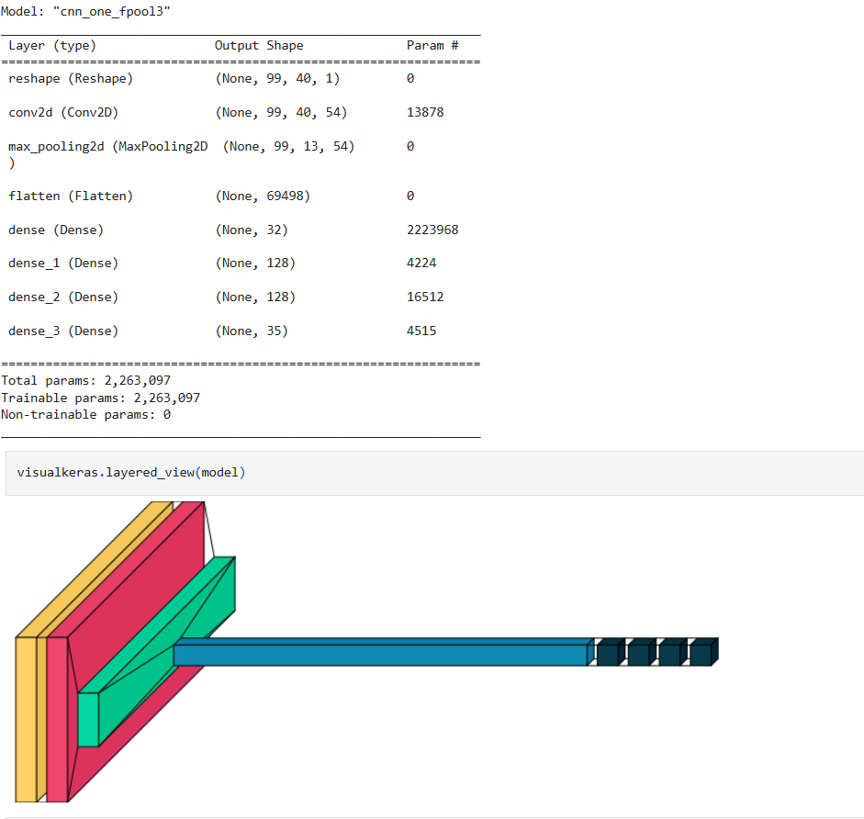
13
MODEL
IIT Madras | 2024

Slide 15
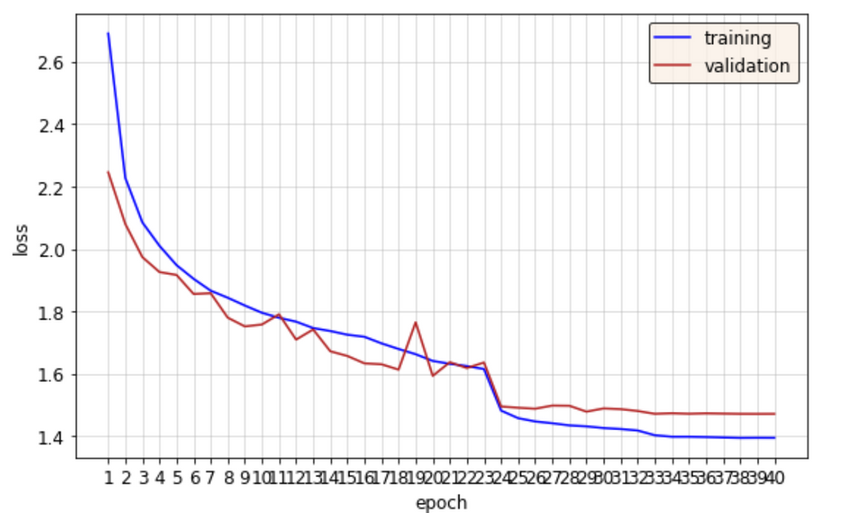
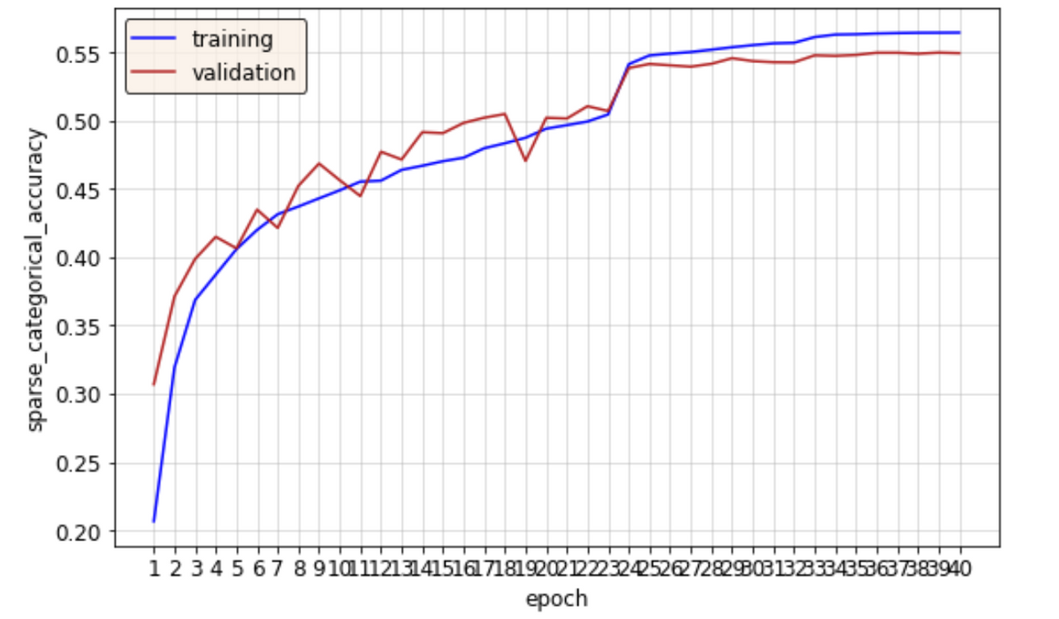
LOSS AND ACCURACY
14
IIT Madras | 2024

Slide 16
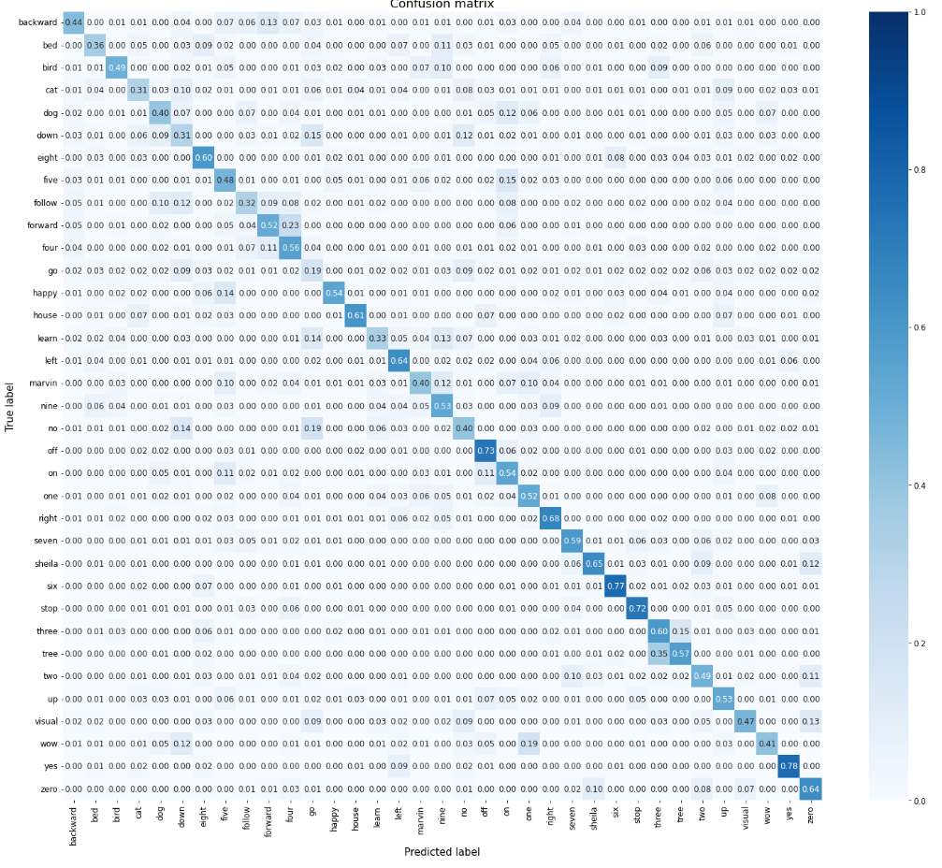
15
RESULT
ACCUCRACY ON
TEST DATA : 52.99%
(CLEARLY CONFORMERS OUTPERFORM)
IIT Madras | 2024

Slide 17
IIT Madras | 2024
THANK YOU

